Slide 1

Overview
National Contact Tracing Induction Programme
Rev 04 14/4/20

Slide 2

Aim
The aim of this programme is to provide you with the knowledge and skills required to support the contact tracing process for COVID-19/Coronavirus
Notes:
The aim of this programme is to provide you with the knowledge and skills required to support the contact tracing process for COVID-19/Coronavirus

Slide 3
Sections
Section 1 – Corona Virus Background
Section 2 – Spread in the Population
Section 3 – Contact Tracing
Notes:
We will cover the basic knowledge required around the corona virus and the disease first and then we will look at the process of making the call. You will have an opportunity to look at the skills required for making the call and the frequently asked questions that you might encounter.
Lastly you will have an opportunity to look at the data management system and learn how to input the data from the call.

Slide 4
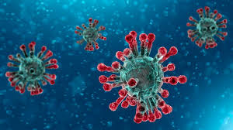
Section 1 – Corona Virus Background

Slide 5
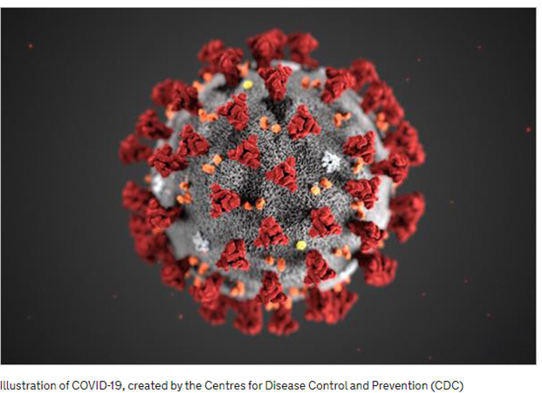
What is a Coronavirus?
A coronavirus is a type of Zoonotic virus found in animals and humans.
As a group, coronaviruses are common across the world.
Notes:
A coronavirus is a type of Zoonotic virus found in animals and humans.
As a group, coronaviruses are common across the world.

Slide 6
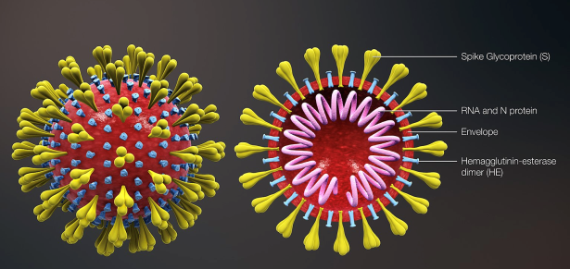
Corona Virus
There are 7 known coronaviruses which infect and spread between humans:
4 of these cause “common cold” type symptoms
SARS-CoV caused a large outbreak originating in China in 2003
MERS-CoV is an ongoing low-level outbreak mainly in the Middle East – most cases are from animal (camel) exposure
SARS-CoV-2 is microbiologically similar to SARS-CoV
Notes:
There are a number of corona viruses and you will be familiar with the common cold which is actually a corona virus and you may remember hearing about SARS which caused a large outbreak in China back in 2003. This new virus is similar to SARS and is actually called SARS-COV-2

Slide 7
Virus v Disease
SARS-CoV-2 is the name of the virus
COVID-19 is the name of the disease
Notes:
Some people might be a little confused about the two terms, so Sars-CoV-2 is the name of this particular Corona Virus and COVID-19 is the name given to the resulting disease.

Slide 8
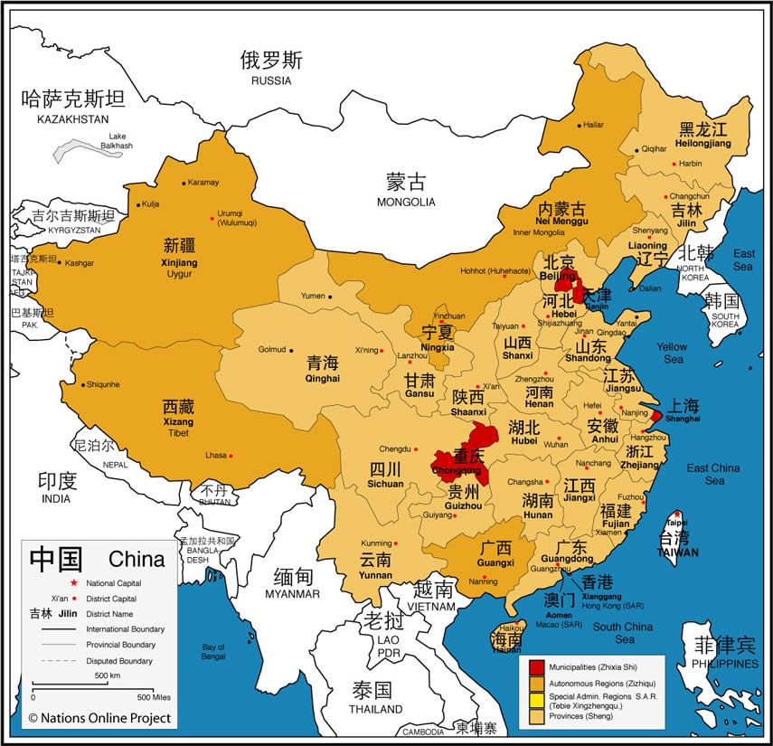
Where it started?
Originated in a city called Wuhan in the Hubei province of China

Slide 9
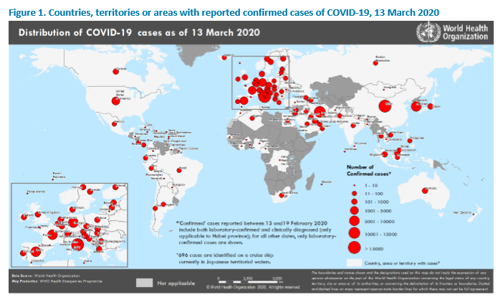

Pandemic
The World Health Organisation has declared the Covid-19 outbreak to be a pandemic.
A pandemic is declared when a disease affects a lot of people in a lot of countries and spreads rapidly.

Slide 10
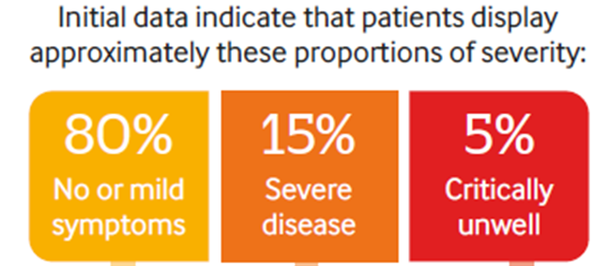
Impact of Covid-19
80% of cases have mild symptoms.
15% of people infected become severely unwell
5% become critically un-well
Fatality rate increases with age and depends on other underlying conditions

Slide 11

Section 2 – Spread in the Population

Slide 12
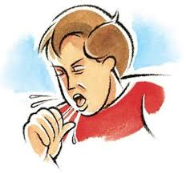
How does the virus spread?
Aerosol Spread
When someone with the infection coughs or sneezes they can spread the germ through the air to people close to them
Droplet Spread
When someone coughs or sneezes and droplets land or surfaces close to them
These surfaces can include door handles, table tops, counter spaces, taps, sinks, kitchen utensils, towels & face clothes.
Notes:
We are still learning about how easily the virus spreads between people.

Slide 13
Phases of the Outbreak
Containment
Preventing spread
Isolation of cases
Tracing and quarantine of contacts
Good Hygiene practices
Delay
Slowing down spread
Isolation
Quarantine
Good Hygiene practices
Social Distancing
Mitigation
All above measures plus
Treating the cases while maintaining health services

Slide 14
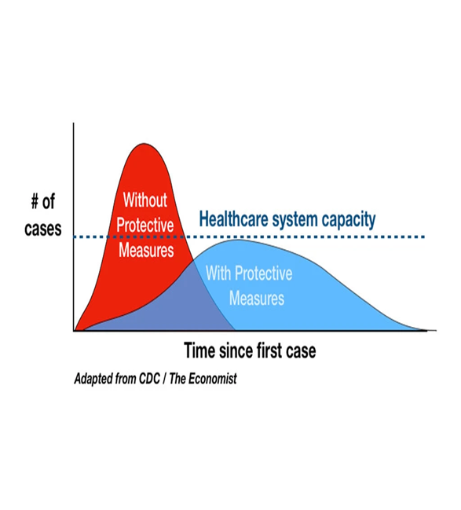
Delay Phase Slowing down the Outbreak
We are trying to slow down the spread of COVID-19 so that the health system is not over burdened.
One of the ways of slowing down the spread of Covid-19 is by tracing people who have been in close contact with confirmed cases and managing them to prevent on-going transmission.
Epidemiological Curve
Notes:
We are trying to slow down the spread of COVID-19 so that the health system is not over burdened.
One of the ways of slowing down the spread of Covid-19 is by tracing people who have been in close contact with confirmed cases and managing them to prevent on-going transmission.
Refer to Epidemiological Curve – The objective is to flatten the curve by slowing down the spread and contact tracing is key to this.
Epidemiology
Epidemiology is the study and analysis of the distribution, patterns and determinants of health and disease conditions in defined populations. It is a cornerstone of public health, and shapes policy decisions and evidence-based practice by identifying risk factors for disease and targets for preventive healthcare

Slide 15
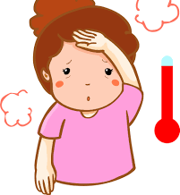



Symptoms
1. Fever
Feeling hot /feverish
(A high temperature is anything above 38⁰ c or 100.4 º F)
2. Cough
3. Breathing Difficulty
Shortness of breath
The time between exposure to the virus and onset of symptoms can be up to 14 days but this can be shorter.
Notes:
Symptoms of COVID-19 are similar to influenza, with a broad spectrum of severity:
The 3 main symptoms are
Fever
Respiratory symptoms – cough and shortness of breath, sore throat
Small group of people may progress to acute respiratory distress syndrome and/or septic shock (requiring ICU support)
Potentially large numbers of people will be asymptomatic and minimally symptomatic cases

Slide 16
Those most likely to become unwell
These include;
Elderly people
People with underlying health conditions
(high blood pressure, diabetes, chronic respiratory disease, immuno-compromised patients )
Healthcare workers treating cases

Slide 17
What is the Infectious Period?
The infectious period is defined as :
From the date of onset of the first symptoms until the person is classified as no longer infectious by the treating team

Slide 18

What about Children?
Disease in children appears to be relatively mild.
A large study from China suggested that just over 2% of cases were under 18 yrs. Of these, fewer than 3% developed severe or critical symptoms of disease.
Children with underlying health conditions may be more vulnerable.
Notes:
Disease in children appears to be relatively mild.
A large study from China suggested that just over 2% of cases were under 18 yrs. Of these, fewer than 3% developed severe or critical symptoms of disease.
Children with underlying health conditions may be more vulnerable.
There is emerging evidence that suggests that while children may not experience symptoms they may be transmitters of the disease

Slide 19
Is there a risk in pregnancy?
We are still learning about coronavirus (COVID-19). We don't yet know how it affects pregnant women and their babies.
There is currently no evidence that pregnant women are more vulnerable.
At present, there is no evidence of transmission of COVID-19 from mother to baby occurring during pregnancy.
Breast feeding – can continue -however advice needs to be sought from GP, Midwife.
Notes:
hse2

Slide 20
Covid-19 Public Health Measures
Guidance on how to protect yourself & others
Contact Tracing
Social Distancing
Self-Quarantine
Self-Isolation

Slide 21
Social Distancing
Social distancing is a term applied to certain actions that are taken by Public Health officials to stop or slow down the spread of a highly contagious disease.
Examples of Social Distancing
Schools, Colleges, Child care facilities closed
Indoor mass gatherings of >100 people cancelled
Outdoor mass gatherings of >500 people cancelled
Notes:
While the term may seem new, the concept is actually quite old.
We’ve been “distancing” ourselves from sick people to prevent spread of disease. – ref leper colonies
The approach was used in the influenza epidemic in 1918 where cities that quarantined sick patients and closed schools, theatres and churches cut their death rate in half.
While the term may seem new, the concept is actually quite old.
We’ve been “distancing” ourselves from sick people to prevent spread of disease.
The approach was used in the influenza epidemic in 1918 where cities that quarantined sick patients and closed schools, theatres and churches cut their death rate in half.
Examples of Social Distancing
Schools, Colleges, Child care facilities closed
Indoor mass gatherings of 100 people cancelled
Outdoor mass gatherings of >500 people cancelled

Slide 22

Social Distancing
At least 2 metres (6.5 feet) distance between people (particularly those who are coughing, sneezing or have a fever).
No handshaking or hugs -
Avoid crowds, sporting events, concerts etc…
www. HSPSC.ie
Notes:
At least 2 metres (6.5 feet) distance between people (particularly those who are coughing, sneezing or have a fever). The reason for this is that if you sneeze or cough by the time it reaches 2 meters it will be diluted.
Remember older people may not use metric measurement so 6.5 feet is equal to 2 meters.
No handshaking or hugs – elbow bump is the new greeting !
Avoid crowds, sporting events, concerts etc…

Slide 23
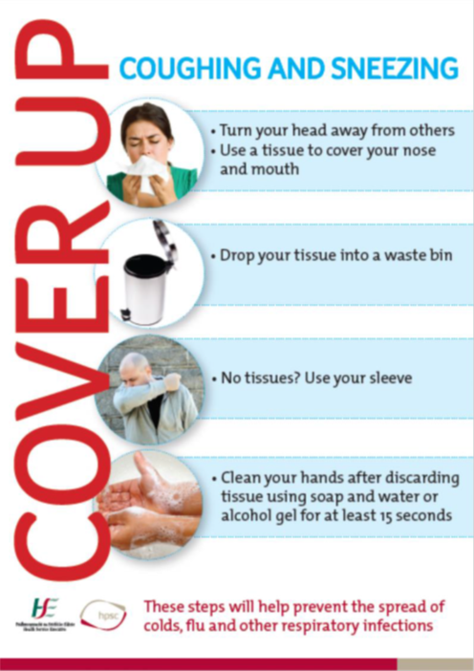
Protecting Yourself & Others
Coughing and Sneezing Etiquette
Hand Hygiene

Slide 24

When to wash your hands
after coughing or sneezing
before and after preparing and eating food
if you were in contact with someone who has a fever or respiratory symptoms
after being on public transport or in a crowd (especially an indoor crowd)
if you have handled animals or animal waste
after toilet use
Moisturise your hands often. Any basic product that is not perfumed/coloured is ok.
Do not wear gloves instead of washing your hands. The virus gets on them in the same way it gets on your hands. Also, your hands can get contaminated when you take the gloves off.
Notes:
hse

Slide 25
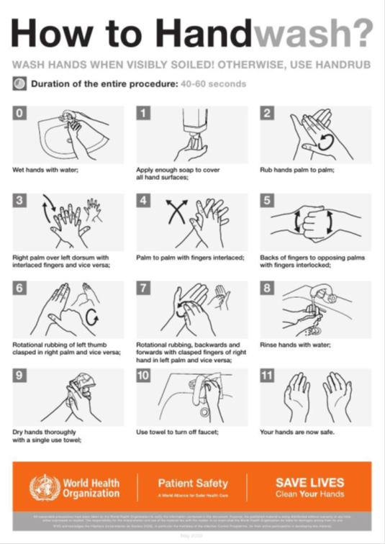

How to wash your hands with soap and water
Wet your hands with warm water and apply soap.
Rub your hands together until the soap forms a lather.
Rub the top of your hands, between your fingers and under your fingernails.
Do this for about 15 seconds.
Rinse your hands under running water.
Dry your hands with a clean towel or paper towel
https://youtu.be/IsgLivAD2FE
Notes:
HPSC

Slide 26

What do we mean by quarantine?
People may be asked to self-quarantine. This is because they have been in close contact with a case of corona virus but have no symptoms.
The period they may be asked to self-quarantine for is usually 14 days from the last contact with the case.
People can still go outside for walks, runs or cycles on their own but you should not spend time in close contact with other people.
Other household members do not need to restrict their activities, unless they are also close contacts of a case.
www.hse.ie

Slide 27
How do people self-quarantine?
Do not go to school, college or work.
Do not use public transport.
Do not go to meetings, social gatherings, group events or crowded places.
Do not have visitors at your home.
Do not go shopping - where possible, order your groceries online or have some family or friends drop them off.
Avoid contact with older people, people with chronic health problems and pregnant women if possible.
Do not travel outside Ireland.

Slide 28
What do we mean by self-isolate?
If during the quarantine period a person develop symptoms of Covid-19, they must self-isolate and phone HSE Live 1850-24-1850.
Once you phone the helpline the person will be assessed and testing will be arranged.
Self-isolation means staying indoors and completely avoiding contact with other people.
before you get tested for coronavirus
while you wait for test results
if you have had a positive test result for coronavirus
The period you may be asked to self-isolate for is from the day of symptom onset until you are classified as no longer infectious by the treatment team.

Slide 29


How do people self-isolate?
Do not go to work, school, religious services or public areas.
Do not share your anything you handle
Do not use public transport or taxis.
Do not invite visitors to your home.
Stay at home, in a room with the window open.
Keep away from others in your home as much as you can. (especially older people, pregnant women or anyone with an underlying health condition)
Check your symptoms - call a doctor if they get worse.
Phone your doctor if you need to - do not visit them.
Cover your coughs and sneezes using a tissue - clean your hands properly afterwards.
Wash your hands properly and often.
Use your own towel - do not share a towel with others.
Clean your room every day with a household cleaner or disinfectant.
For more information refer to https://www2.hse.ie/conditions/coronavirus/coronavirus.html

Slide 30
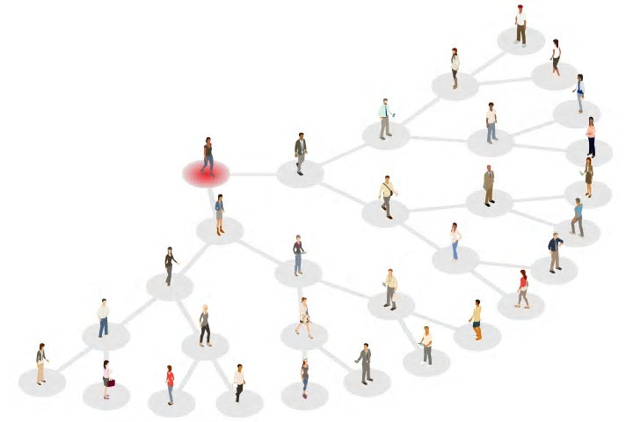
Section – 3 Contract Tracing

Slide 31

What is Contact Tracing?
Contact tracing is the process of identifying all people to whom a confirmed case may have transmitted the infection, and putting in place measures to ensure these exposed people do not further transmit disease

Slide 32

What does it involve?
Phoning those people who were in contact with a confirmed case of COVID-19 to provide
Advise
Guidance
Information

Slide 33
Definition of a contact
Anyone who has been in contact with someone who has been confirmed as having Covid-19.
The contact timeframe is from the day the infected person showed signs of symptoms until the infected person is no longer classified as infectious by the treating team. (usually 24 hours after symptom resolution)

Slide 34
Types of Contact
Close Contact
Casual Contact
Unknown Contacts

Slide 35

Definition of a Close Contact
Is defined as an individual who has had greater than 15 minutes face-to-face contact with a confirmed case of Covid-19 in any setting within less than 2 meters distance.
˃2 mtrs
HSE National Interim Guidelines for the public health management of contacts of cases of covid-19, including healthcare workers

Slide 36




Examples of Close Contacts
Household contacts
Closed space contact
Healthcare workers
Passengers on an aircraft
HSE National Interim Guidelines for the public health management of contacts of cases of covid-19, including healthcare workers
Notes:
Household contacts defined as living or sleeping in the same home, individuals in shared accommodation sharing kitchen or bathroom facilities and sexual partners.
Healthcare workers, including laboratory workers who
have not worn appropriate PPE or had a breach in PPE during the following exposures to the confirmed case
Had direct contact with the case (as defined above), their body fluids or their laboratory specimen
Were present in the same room when an aerosol generating procedure is undertaken on the case.
Passengers on an aircraft sitting within two seats (in any direction) of the COVID-19 case, travel companions or persons providing care, and crew members serving inthe section of the aircraft where the index case was seated
For those contacts who have shared a closed space with a confirmed case for longer than two hours, a risk assessment should be undertaken taking into consideration the size of the room, ventilation and the distance from the case. This may include office and school settings and any sort of large conveyance.

Slide 37


Characteristics of a Casual Contact
Any individual who has shared a Closed Space with a confirmed case for less than two hours
Any individual who has shared a closed space with a confirmed case for longer than two hours, but following a risk assessment, does not meet the definition of a close contact.
Passengers on an aircraft sitting beyond two seats (in any direction) of a confirmed case.
2 hours

Slide 38
Confidentiality & GDPR
Form to be inserted here – Lorraine Murphy

Slide 39

Additional Modules
Module 1 – How to conduct Call 1 - Index Case
Module 2 – How to conduct Call 2 – Identify Contacts
Module 3 – How to conduct Call 3 – Close Contacts

Slide 40

Material Prepared by the
HSE National Contact Tracing Programme
Training & Resources Team
Refer to www.????? for up-to-date materials

